Slide 1

Understanding Fast Neutrons Utilizing a Water-Cherenkov Detector and a Gas-filled Detector at the Soudan Underground Laboratory
M.S. Thesis Defense, Physics
Chiranjibi Ghimire
July 31, 2015
M.Sc. Physics, Tribhuvan University, Nepal

Slide 2
Outline
High Energy Neutron Problem
Underground Physics and Motivation
Estimation of High Energy Neutron by combining two separate detectors
Detection Technique
Data analysis
Results
Conclusion

Slide 3
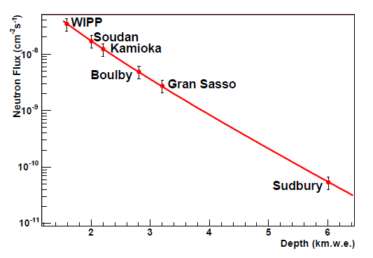
High Energy Neutron Problem
Problem: High energy neutron mimic the WIMP signal
Estimate the number of expected high energy neutron
background
-
http://arxiv.org/abs/astro-ph/0512125

Slide 4
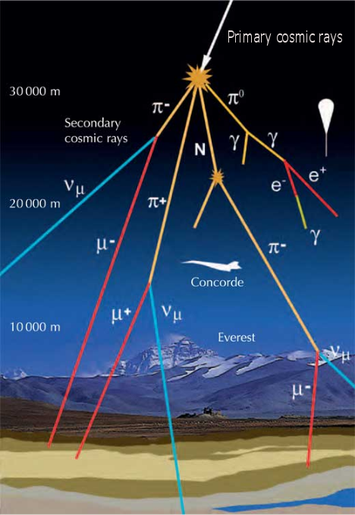
Extra Terrestrial Background in Physics Experiments
Cosmic-ray muons:
Highly energetic and highly penetrating charged particle
and go deep underground
Bombard us at the rate of 1 cm⁻² minute⁻¹

Slide 5
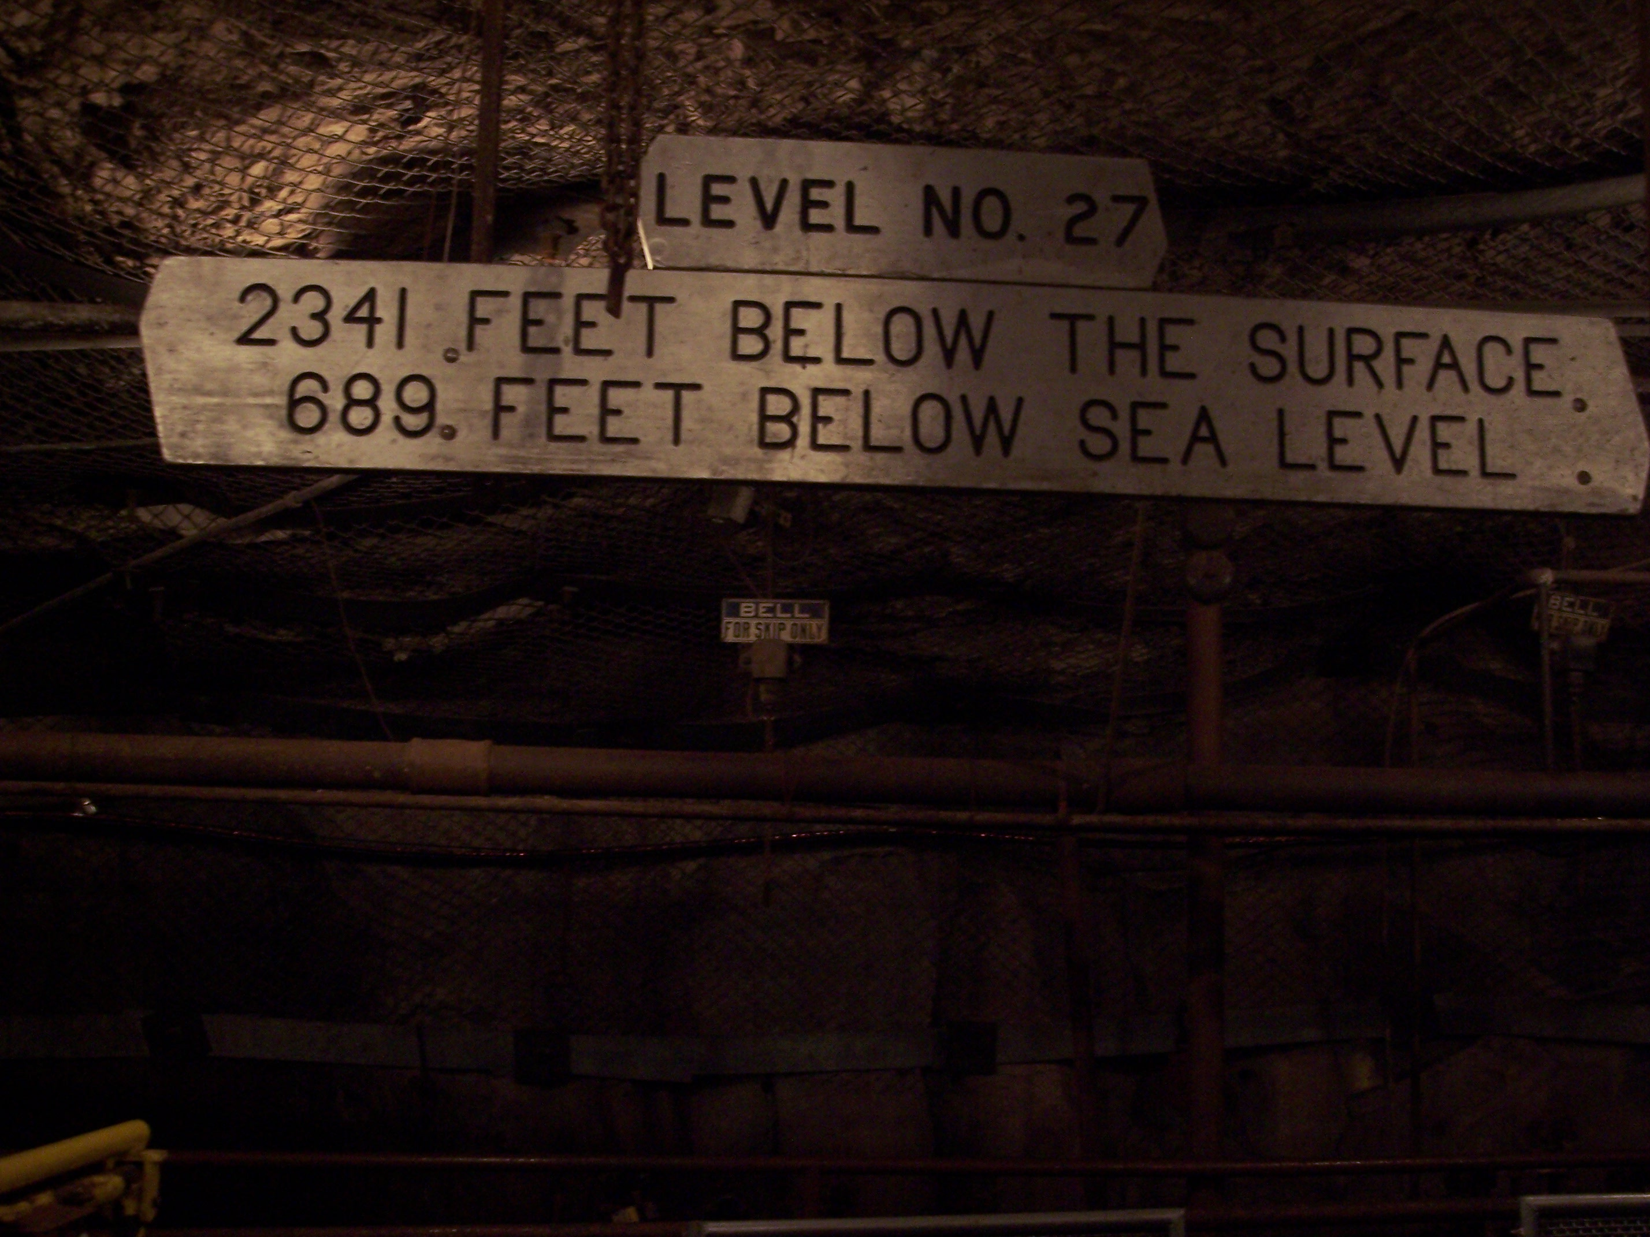
Underground Physics and Motivation
Detectors search for rare events are extremely sensitive
to some natural radiations
Despite of hassle and high budget, physics experiments
must perform underground to shield from cosmic-ray muons
Number of cosmic-ray muons reduce by a factor of 100,000
from the number at surface

Slide 6
High Energy Neutron Production in Underground
Produced by cosmic-ray muons interaction with lead: Energy up to 100’s of MeV

Slide 7
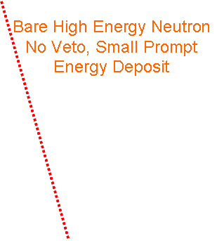
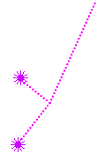
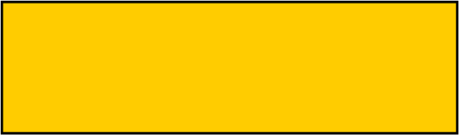
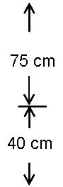
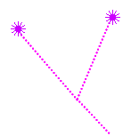
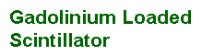
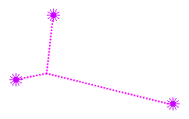

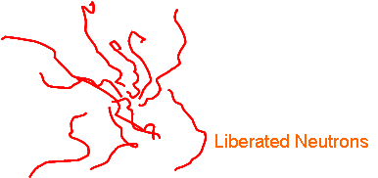
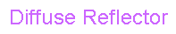
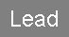

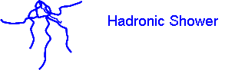
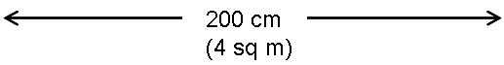
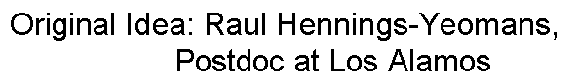
Detection Technique
The Original Idea
Veto
PMT
Capture on Gd, Gamma
(spread over 30’s μs)
Veto
Veto

Slide 8
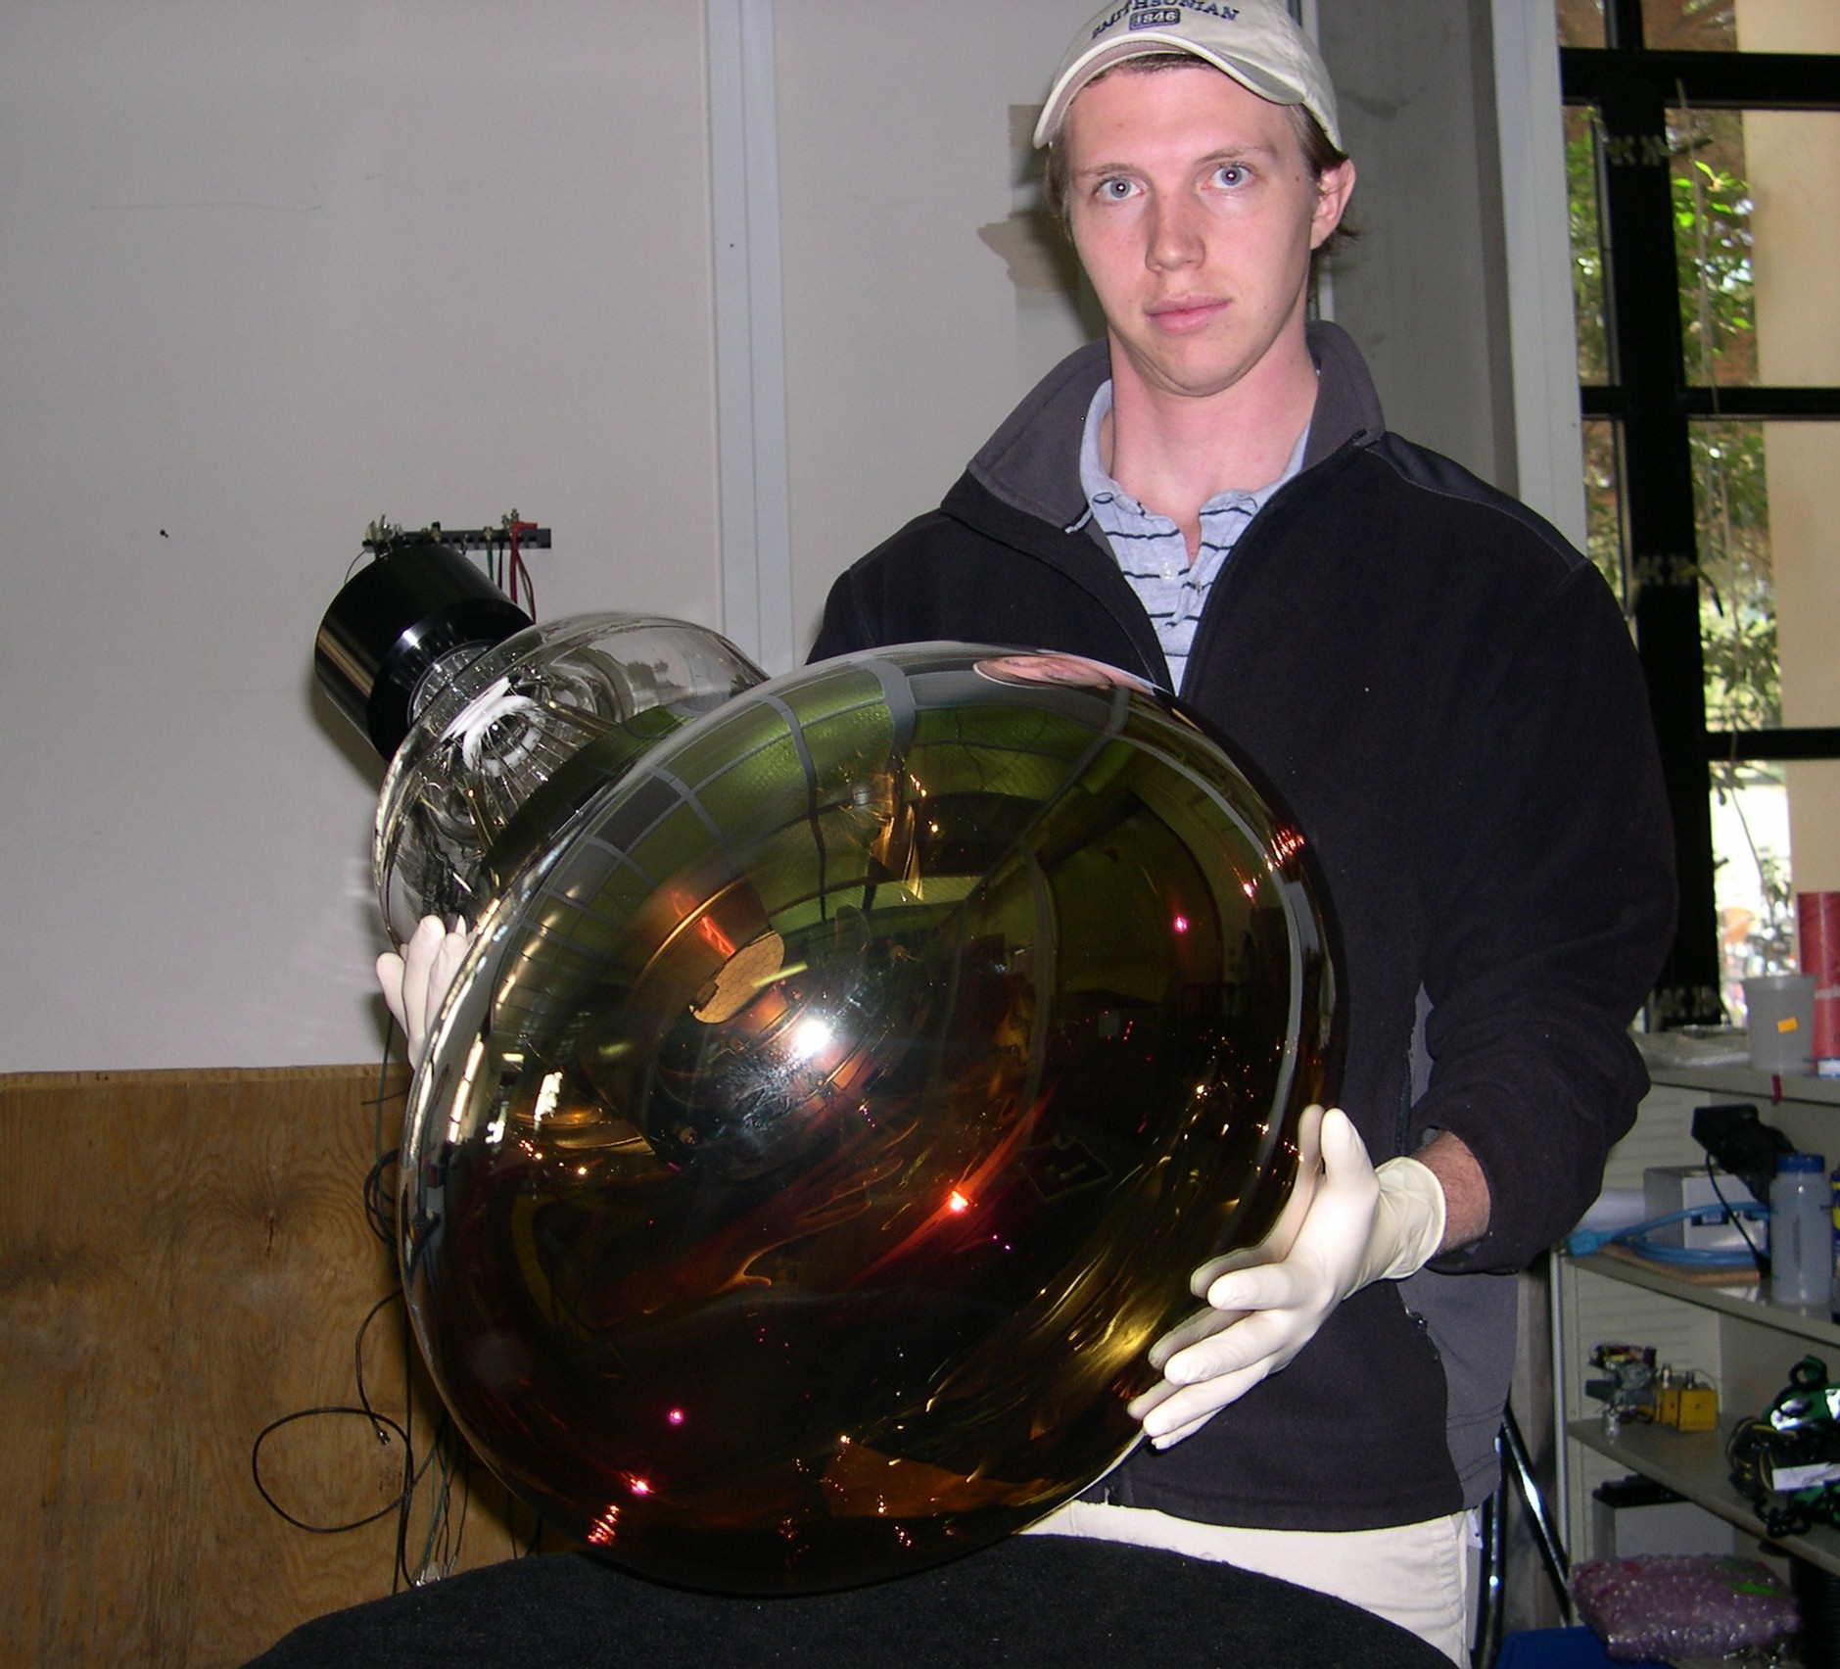
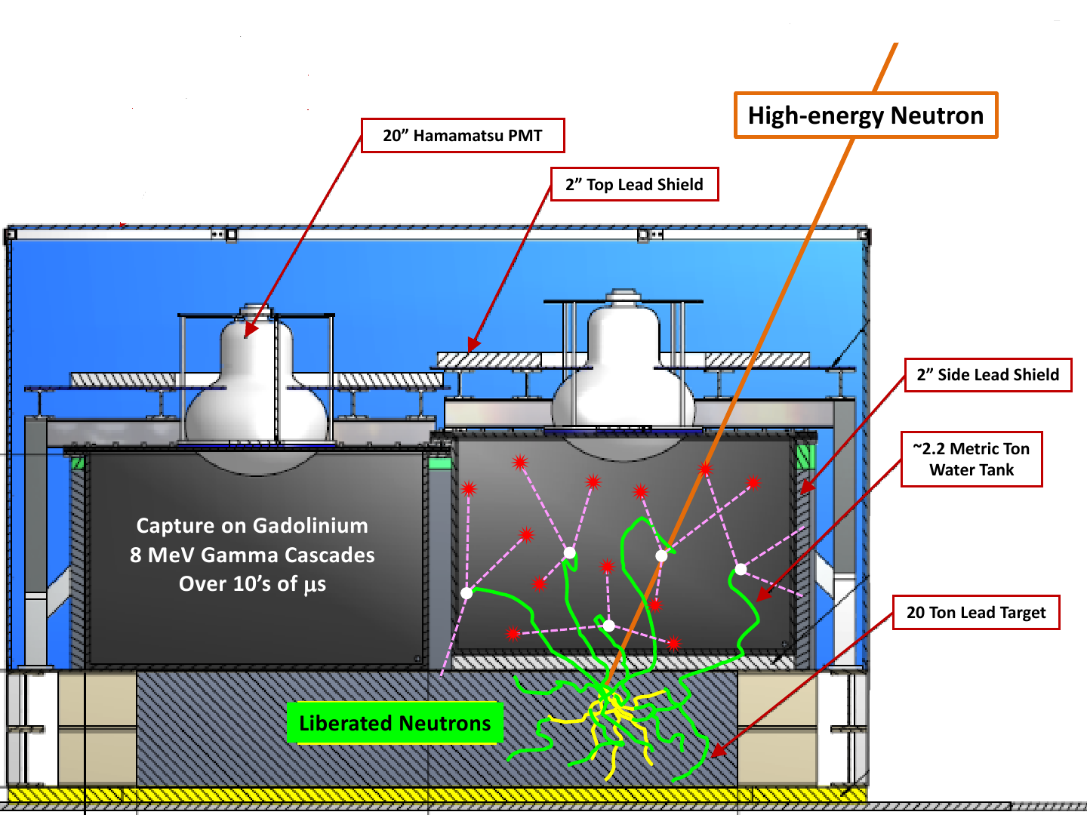
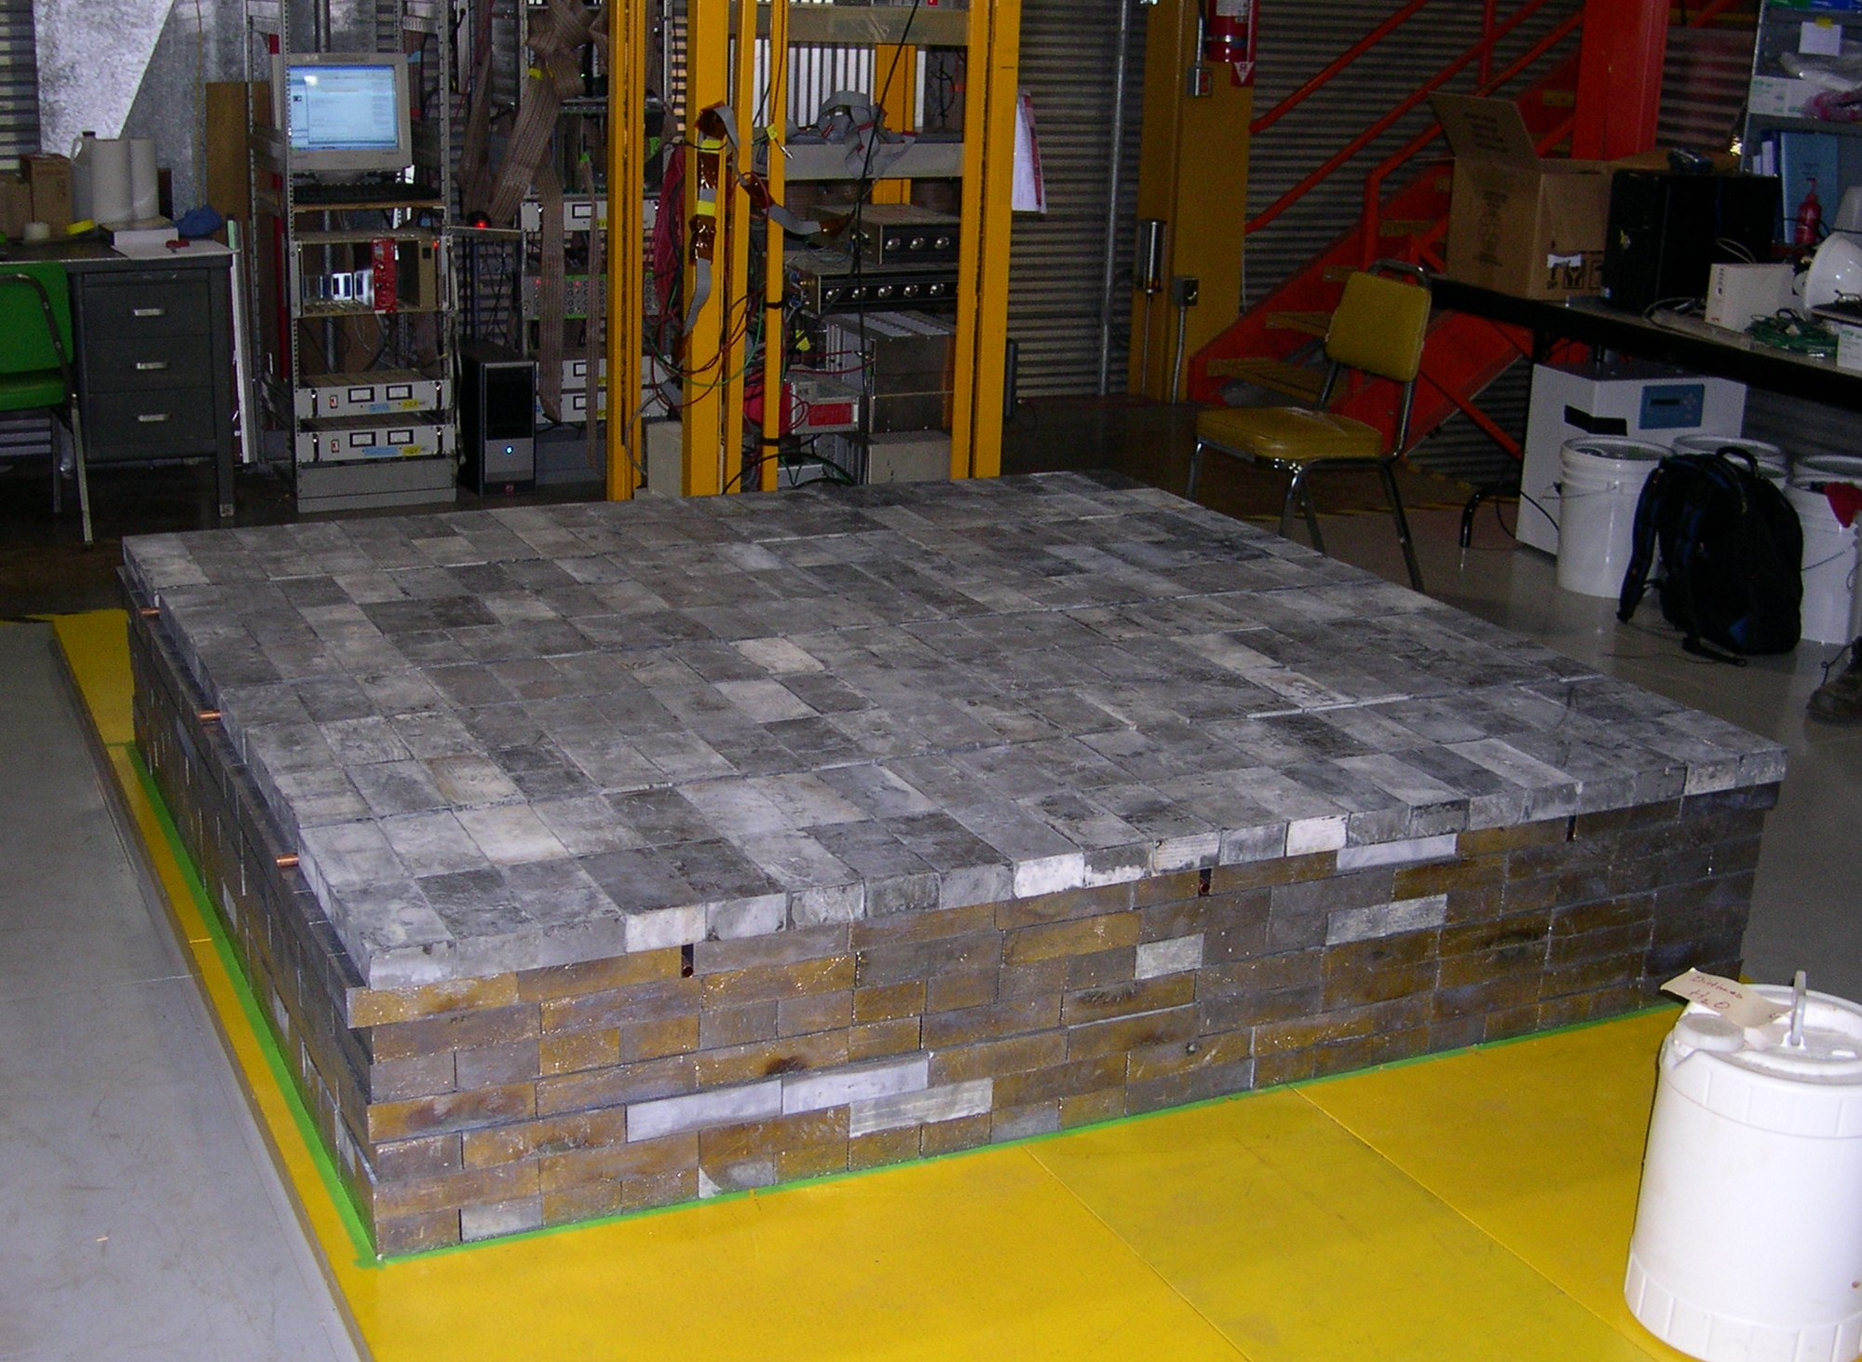
Neutron Multiplicity Meter (NMM

Slide 9
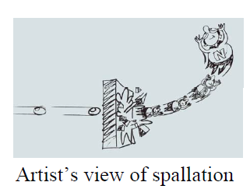
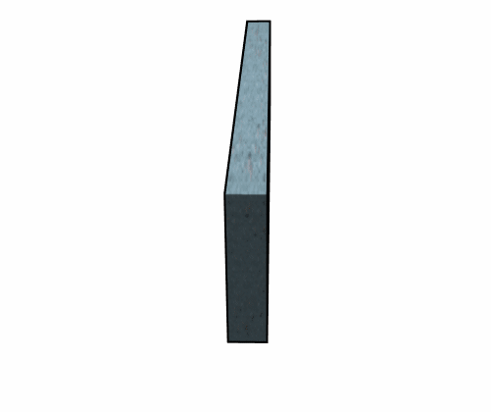
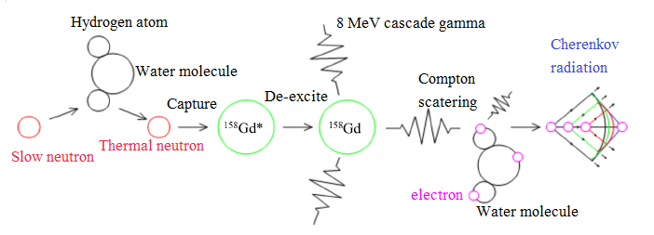
Neutron Spallation and Capture
Adapted from Nabin Poudyal’s thesis

Slide 10
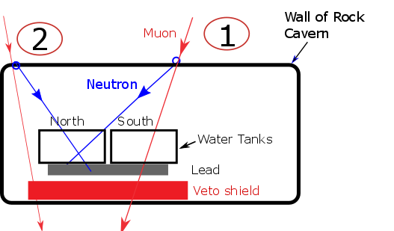
Combining an NMM With a Veto shied
- High energy neutron flux has been already predicted
- My goal is to estimate high-energy neutrons associated with a nearby muon in the veto shield

Slide 11
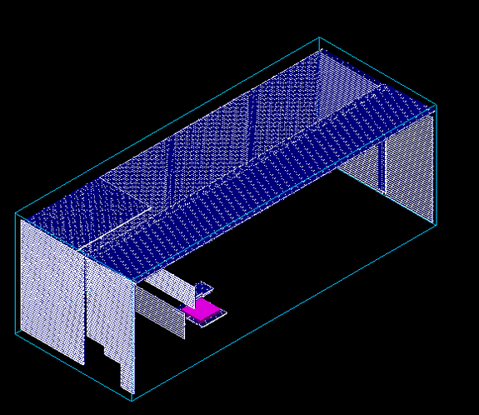
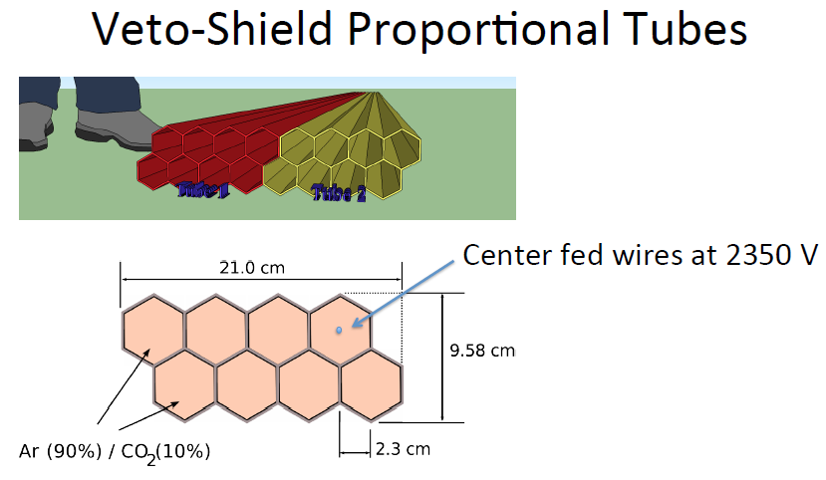
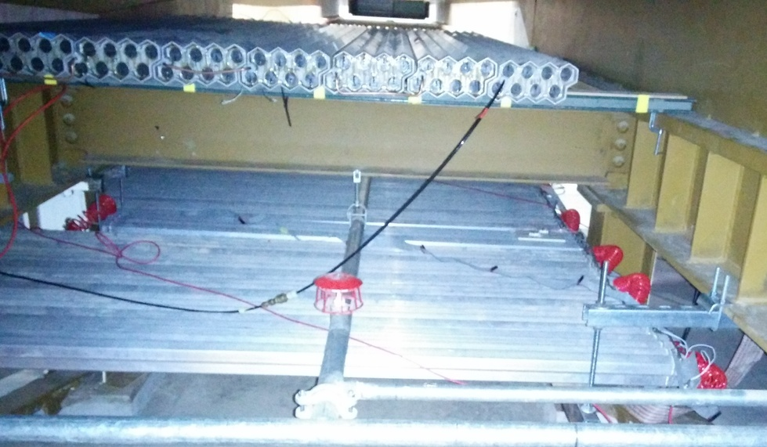
Veto shield (Gas-filled)

Slide 12
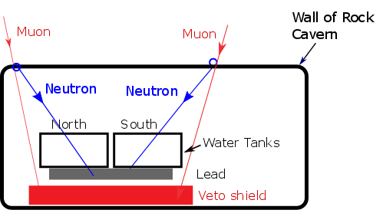
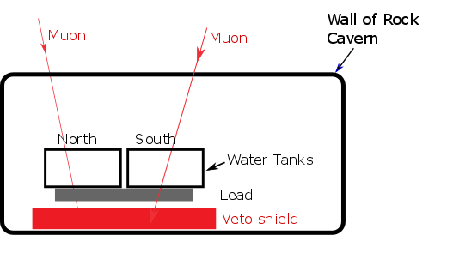
Data Analysis
Goal:
Quantify the signal-like events associated with a nearby muon in the veto shield
Signal
Background

Slide 13
Data Analysis I
Overview:
Start with subset of NMM neutron-trigger data (152,000 events): which all have multiplicity of five and associated veto shield data with 71.4 days of livetime
Combine the NMM data and veto shield data
Application of four selection criteria
Estimate the efficiencies for all four selection criteria with uncertainties

Slide 14
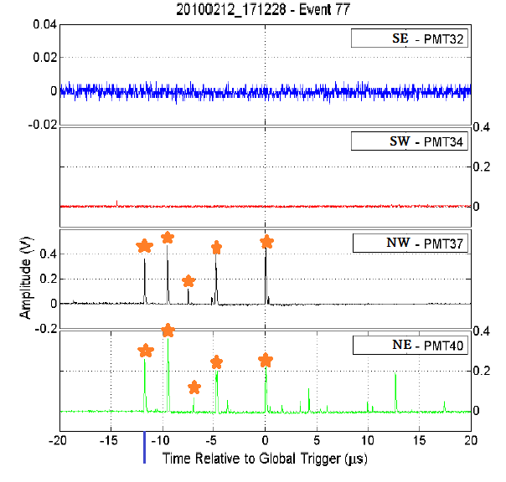
NMM Trigger Condition (Neutron Mode)
NMM hardware required multiplicity-5 in 60 μs to be triggered
This is where those events (152,000 events) comes from

Slide 15
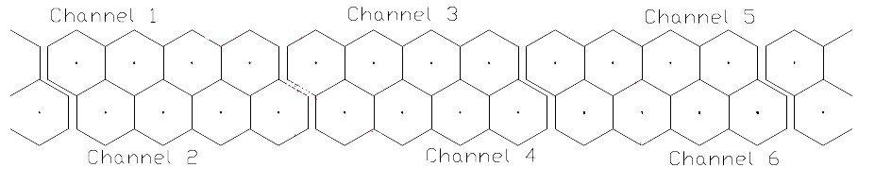
Selection Criteria
Pre-skim Selection Criterion I :
I. Muon Selection- Requires a muon-like straight track (signature) on both veto-shield panels

Slide 16
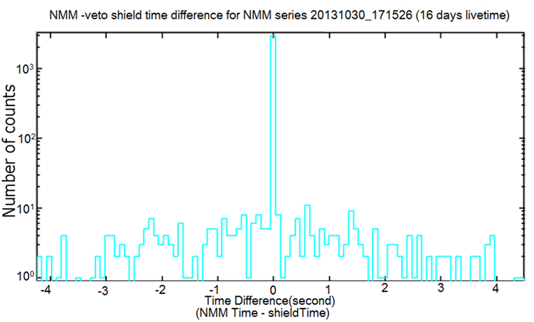
Pre-skim Selection Criterion II
II. Select NMM events which are broadly close-in-time (± 5 s) with veto shield muon-like events
- Application of pre-skim selection criterion reduces the number of NMM events from 152,000 to 15,804

Slide 17
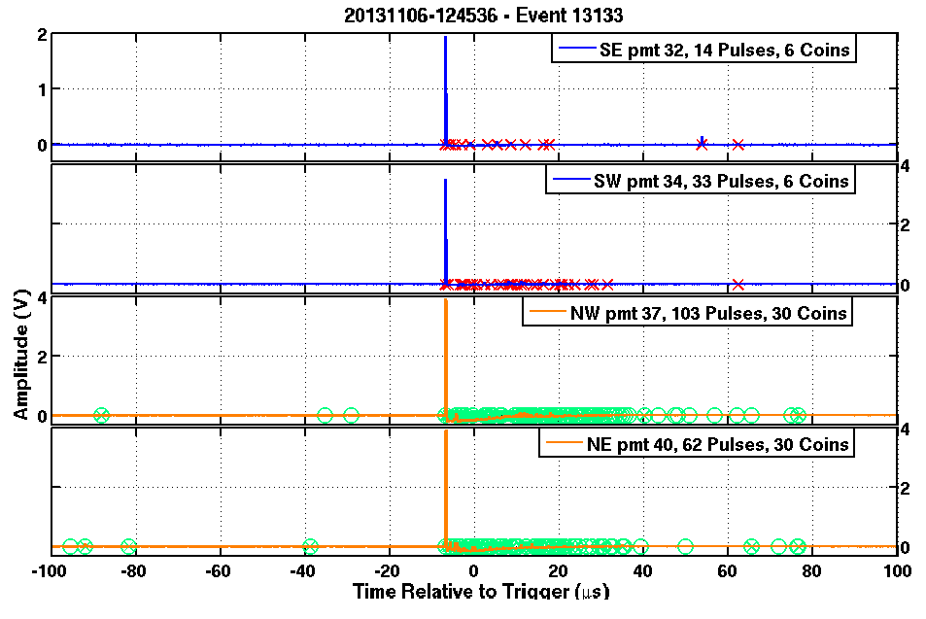
Skim Selection Criterion
I . Muon rejection in NMM:
- Rejects large pulses in the NMM
Background

Slide 18
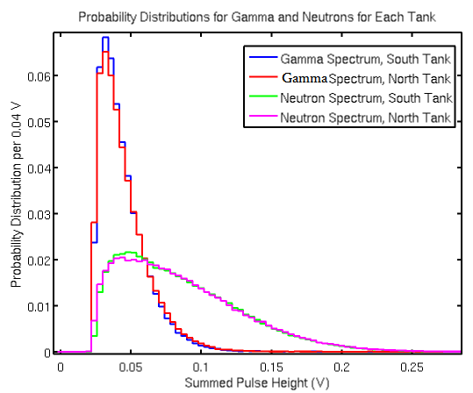
Skim Selection Criterion II
Keeping neutron-like events as a signal
Events with summed pulse height less than 0.2 V are either a neutron or a gamma events
Will further apply selection criterion to distinguish gamma and neutron

Slide 19
Skim Selection Criterion I
II. Multiplicity Requirement: Gamma rejection
- Multiplicity = Number of coincident pulses, between two PMTs on single tank, recorded in a NMM trigger time-window
- Requires at least multiplicity 2 on each tank
- Application of skim selection criterion reduces the number of NMM events from 15,804 to 33
- Rejecting muon alone gets rid of 94% of the data. Of the remaining 6%, almost (97%) events are discarded as gamma events. Only 1% of events passes the skim selection criterion.

Slide 20
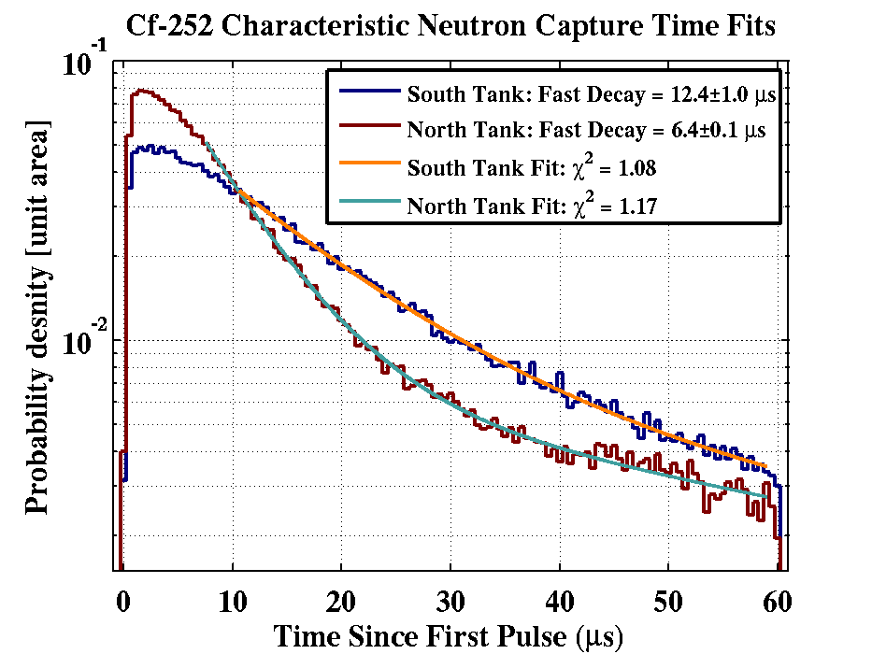
Coincidence Selection Criterion: Time Window Selection
- I want to maximize the neutron acceptance
- A 200 μs time window is 16 times the characteristics time for neutron capture on Gd
This work was done by Ray Bunker and Yu Chen

Slide 21
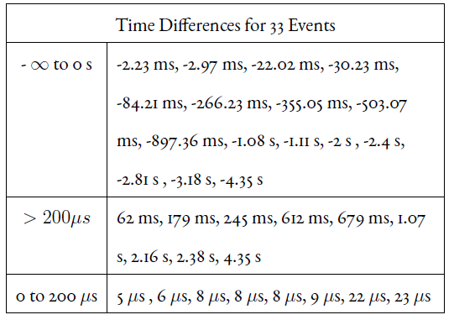
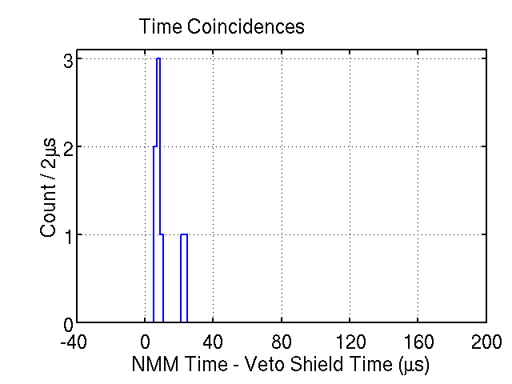
Coincidences Selection Criterion: Time Window
Selected events

Slide 22
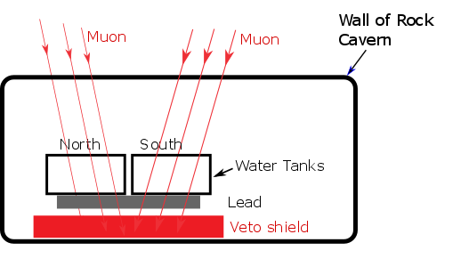
Hit Pattern Selection Criterion
Hit Pattern: Select events caused by a single charged particle
- I looked muon-trigger data and I found 94% of events are consistent with single hit pattern
- More than one hit-pattern in the veto shield are highly-unlikely to caused by a single muon

Slide 23
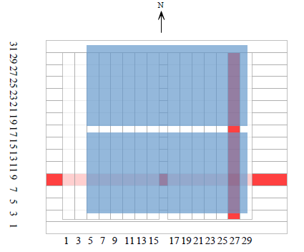
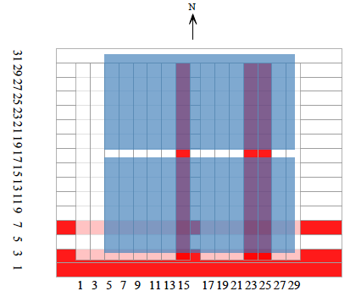
Hit Pattern Selection Criterion I
Top Panels
Bottom Panels
Accepted Event
Rejected Event

Slide 24
Final Events
After applying fourth selection criterion, only three events remain and five events rejected
All these accepted events have a single hit pattern in the veto shield
These three accepted-events are my high-energy neutron candidates associated with a nearby muon
Looked NMM traces of three accepted events to make sure they were good candidates

Slide 25
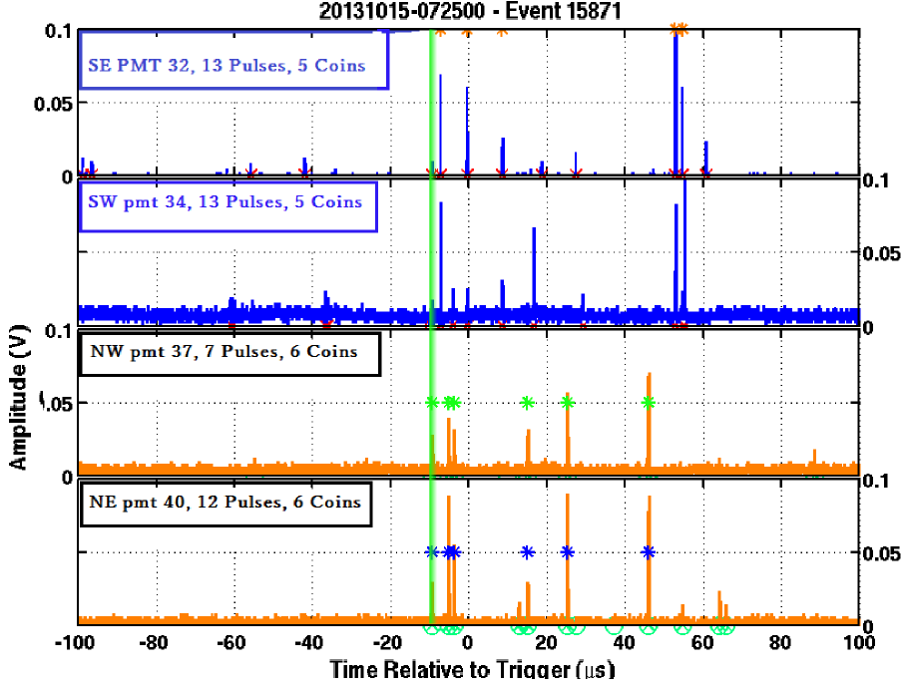
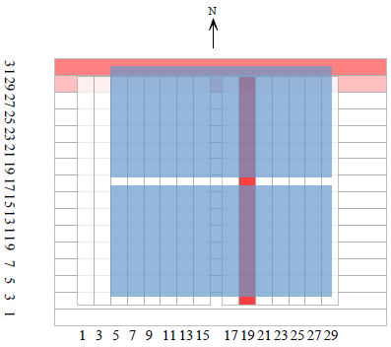
Final Events I
NMM trace:
- Small and multiple pulses
- Single hit pattern

Slide 26
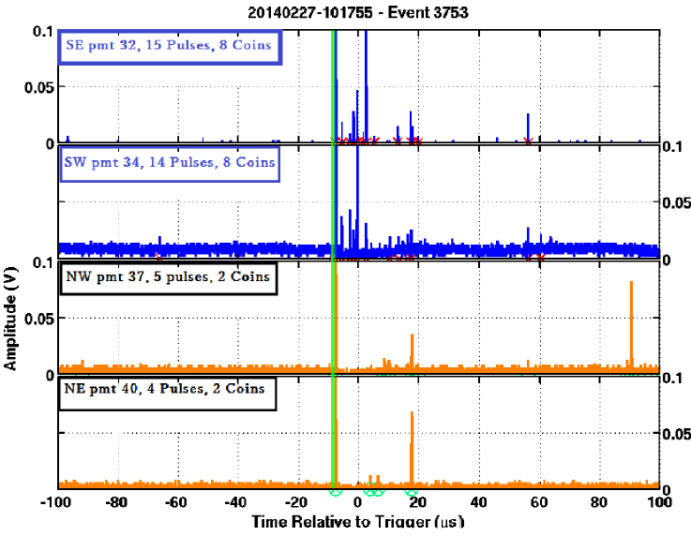
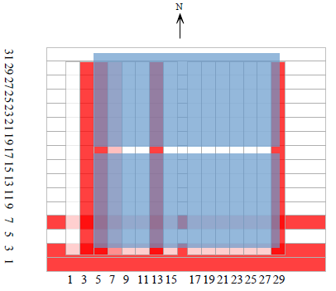
Near Misses: Fails on the multiple hit pattern

Slide 27
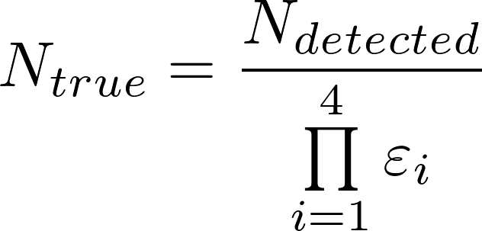
Estimation of High Energy Neutron Acceptance Efficiencies

Slide 28
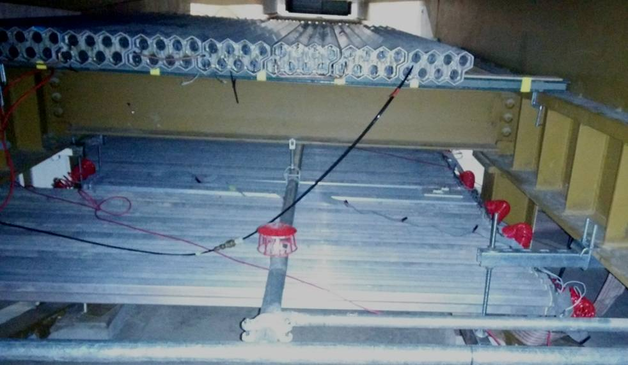
First Part: Veto shield muon-tagging efficiency
- For the top panel alone, the veto shield muon tagging efficiency was calculated by Matt Fritts to be 95±5%
- My selection criterion require both top and bottom panels to tag a through-going muon. I multiplied the single panel efficiency by itself to get the efficiency for my muon tagging efficiency: 90±12%
- Uncertainty associated with this efficiency is due to the gas-pressure variation in the veto shield
Top panel
Bottom panel

Slide 29
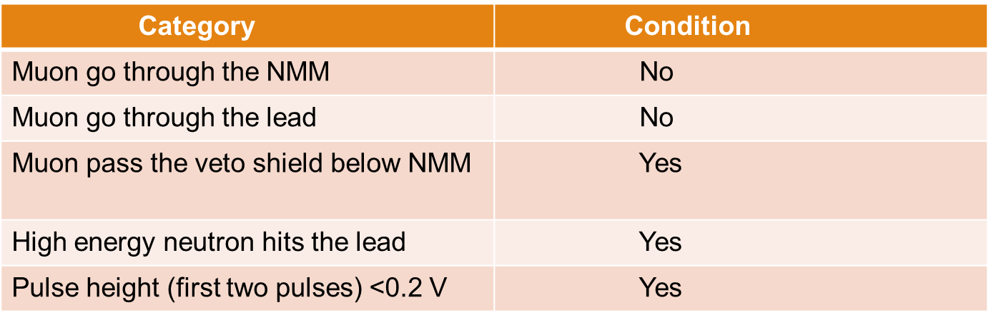
Second Part: NMM efficiency to accepts high-energy neutron candidates
- Yu Chen did simulation (Geant4 Monte Carlo simulation) based on following requirements (see table), and found the efficiency to be 50±32% (stat.)
To be a true signal, an event must satisfy five conditions (see table)
- To be detected, the events must have multiplicity 2
- Reported uncertainty is high, because the simulation detect only few events under this requirements

Slide 30
Muon-like pulse rejection:
- The requirement that all the observed NMM pulses not be too much larger than typical neutron pulse
- Since I require generous pulse height of less than 0.5 V, all neutron-like events are accepted by this selection criterion
- Estimated efficiency to accept neutron-like events is 100%

Slide 31
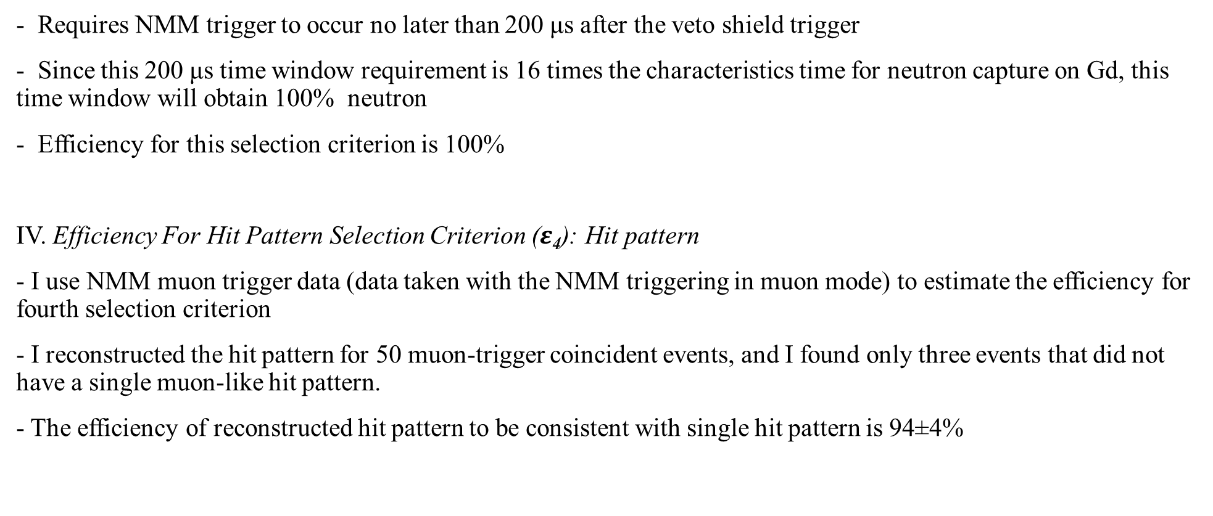

Slide 32
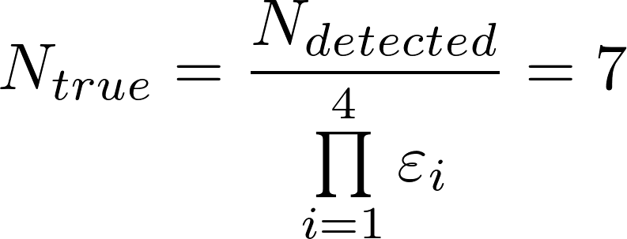
Final Results
Combined efficiency is 42±27% (0.42±0.27)
In my data set, only three events pass all selection criteria which are my high energy neutron candidates, and I divided the 3 observed high energy neutron events by combined efficiency
- True number of incident high energy neutrons associated with a nearby taggable muon to be 7±2

Slide 33
Expected Background
There are two types of expected background: Random and Non-Random Background
1. Random Background:
Definition: Events that are physically unrelated but accidentally happen to occur at nearly the same time
- Events for which the NMM triggered before the veto shield triggered are non-physical and therefore can be used to estimate the random background
- There were 63 accidental coincidences events between -3.0 s to -0.5 s (Figure in slide 17)
- The random accidental background rate is found to be (1.5±0.2) x 10⁻⁶ events/μs/day
- Scaled this rate to my time window of 200 μs and livetime of 71.4 days to be (21±3)x 10⁻³ events in signal region
- Because of the very low expected background events (0.021), the number of random background will be negligible after the selection criterion reduce the random background

Slide 34
Expected Background I
2. Non-Random Background:
Definition: Events that occur nearly at the same time which are physically related, but are not particularly interesting for my analysis
- Typical example of non-random background is when muons pass through the gap between the NMM tanks and then strikes the lead beneath (It is hard distinguish the spallation caused by muon and high energy neutron)
I estimate non-random background by using two different methods:
- Geometrical, Data-Based Argument
- Simulation

Slide 35
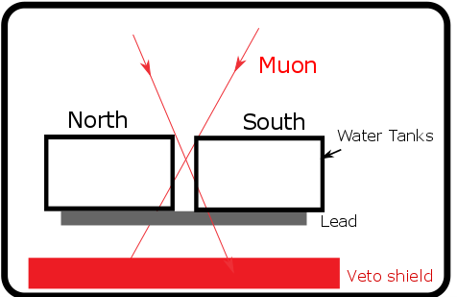
Expected Background II
Geometrical Argument:
- Non-random background can be estimated by selecting the events in which the events has a single hit-pattern in the veto shield just underneath of the gap
- To identify muons that traveled through the gap, I check the three veto-shield tubes (21 cm long each) just below the NMM for a signal
- From geometrical argument, the non-random background is found to be 25±1%
- The uncertainty associated with this background is only statistical
Muon that hit a tube beyond these three tubes have a path length of
at least 30 cm
The path length of muon is considered to be 1 cm per 2 MeV
These muons are easily thrown out by the pulse height selection criterion

Slide 36
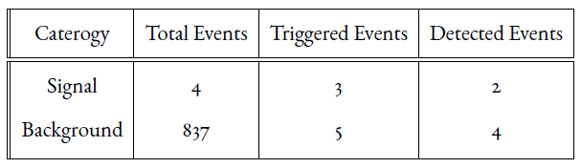
Expected Background III
Simulation :
- Yu Chen’s Geant4 Monte-Carlo simulation is used to estimate the non-random background at 67±25%
- Signal: A muon (first two pulse height >0.2 V) not go through the tanks and lead but pass through the veto shield and high energy neutron hits the lead
- Background: A muon must pass through the lead. The muon still has to miss the tank and pass through the veto shield; there is no condition on the neutron.
Triggered Events: Events in which the NMM would have triggered, this requires at least five coincident pulses within 60 μs
Detected Events: Events which also have at least multiplicity 2 on each tank
This simulation result is based on 217.36 days of livetime

Slide 37
Non-Random Background Results
- The hit pattern selection criterion is not considered to estimate the non-random background because simulation did not apply the hit-pattern selection criterion. So, I had 8 events before applying the fourth selection criterion
- Based on my geometrical background estimate, I predict 2 events of 8 will be my background events
- The simulation, when scaled to my livetime of 71.4 days, predicts 1.3 background events

Slide 38
Comparison My High Energy Neutron Candidates with Mei & Hime Prediction
If we assume the high energy neutrons have a perfectly vertical flux, the total number of high energy neutrons predicted to be 800±380. Under these assumptions, my setup was able to identify 0.8±0.5% of these predicted high energy neutrons.
The gathering power of the neutron in the lead was estimated by Melinda Sweany for different angular distribution. If we assume the angular distribution of high-energy neutrons is the same as for a muons and the total number of neutron predicted by Mei and Hime is correct then combined number of high energy neutron including gathering power of neutron in Soudan Underground Laboratory to be 220±105. Under these assumptions, my setup was able to identify 3±2% of these predicted high-energy neutrons.

Slide 39
Conclusion
Fast neutrons are a problem for rare events searches such as dark matter search and neutrinoless double beta decay experiments
The NMM is deployed to quantify the flux of fast neutrons. The NMM has already observed the fast neutrons. My goal was to estimate the fraction of fast neutrons associated with a near by muon
It is important to understand not only flux of fast neutrons but also how effective an adjacent muon-veto can be at identifying them
The number of incident high-energy neutron events associated with a nearby muon is found to be 7±2 for 71.4 days of livetime
I identify the small fraction of the Mei & Hime predicted high-energy neutrons because of small solid angle in my set up.

Slide 40
Future Follow Up
If someone in the future follows up on my analysis, the following are some ways to improve upon this work.
Loosening the multiplicity restriction in skim selection criterion will significantly improve the statistics
Analyzing the events with more livetime will improve the statistics
Inclusion of a pulse likelihood selection criterion will allows to distinguish the neutron-like and gamma-like signals more accurately
Studying the coincidences between NMM-veto shield muon time and the first NMM pulse-time will give an idea for further selection criterion.
The NMM is located inside the shielded hall and there are also ceiling shield-panels over the NMM. In the future someone can use these ceiling panels to better estimate the muon track and discard muon with paths through lead.
The veto-shied efficiency to tag muons and the NMM efficiency to measure the fast neutrons are already efficient. More veto-shied panels near the NMM would increase the acceptance of muon that does not go through the lead which will allows to better understand the fast neutrons production by muons

Slide 41
The End……..
Thank You
Questions???

Slide 42

Backup Slides
Accepted Events: 2

Slide 43

Accepted Event: 3

Slide 44

Rejected Event:1

Slide 45

Rejected Event:2

Slide 46

Rejected Event:3

Slide 47

Rejected Event:4

Slide 48

Rejected Event:5

Slide 49


Coincidences Study
NMM data structure
Veto shield data structure

Slide 50

Backgrounds in Physics Experiments
Alpha Radiation:
Slow particle with extremely short range (few inches)
Charged and slow moving particle
Can be blocked by a single sheet of paper
Beta Radiation:
High energy and greater range of penetration than alpha
Light, charged, and have relatively short range (few feet)
Can be blocked by using low density materials (plastic, water, etc.)
Gamma Radiation:
Very energetic electromagnetic rays and are penetrating
Can travel thousands of meter
Can be blocked by using high-Z material, such as lead
Neutron Radiation:
Small particle, travels a few feet
Can be blocked by hydrogen-rich materials

